Slide 1

Group : Easy Developer
Member
Mohammad Taslim
Dalawar Hossain
Suman Kumar Dash

Slide 2
Retrofit Library is used for making http calls.
Apache server is used for storing data and images.
Mysql database and php language is used.
JSON is used for collecting data from the server.
GET and POST both method used for request and response between the server and app.
Open weather used for weather information update.

Slide 3

Splash Screen

Slide 4
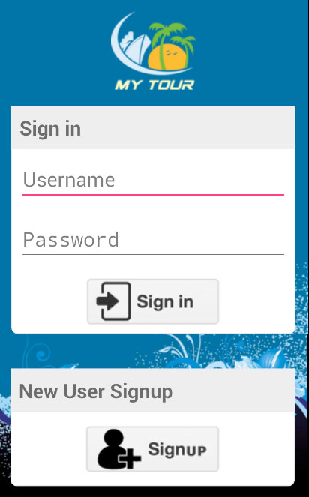
User Login Screen

Slide 5
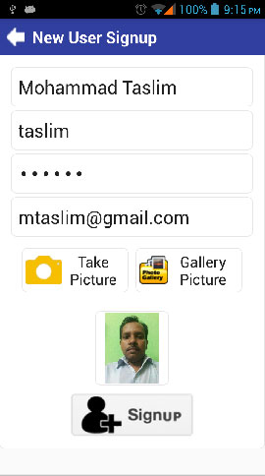
New User Signup Screen

Slide 6
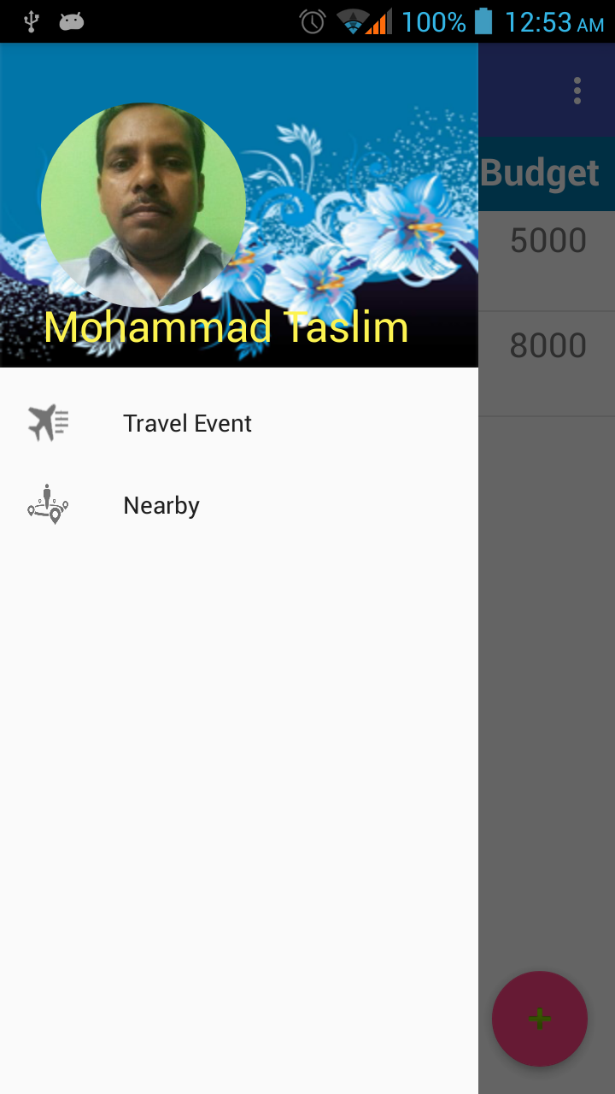
Drawer

Slide 7
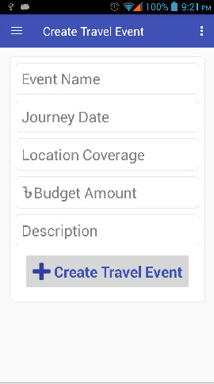
Create Travel Event

Slide 8
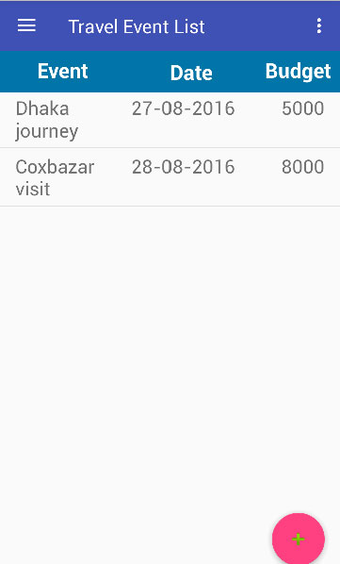
Travel Event List

Slide 9
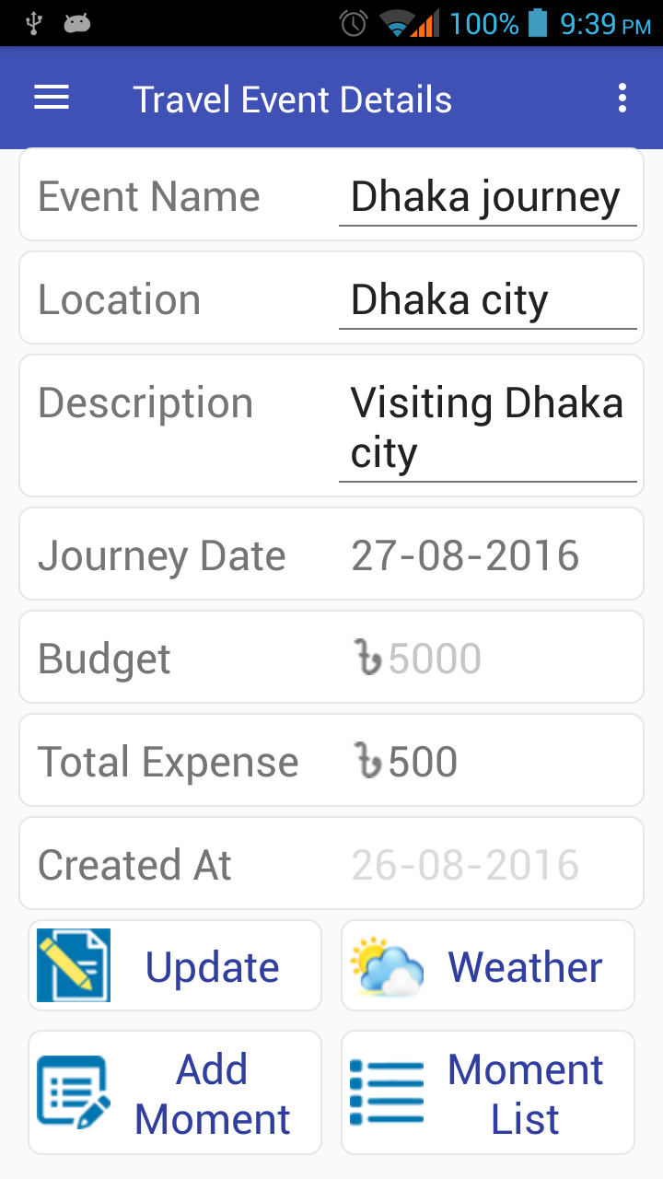
Travel Event Details

Slide 10
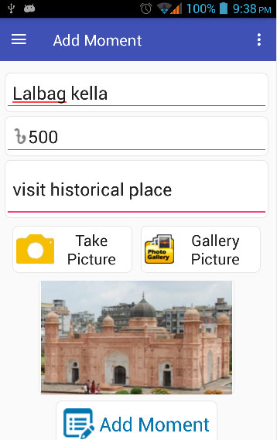
Add Moment

Slide 11
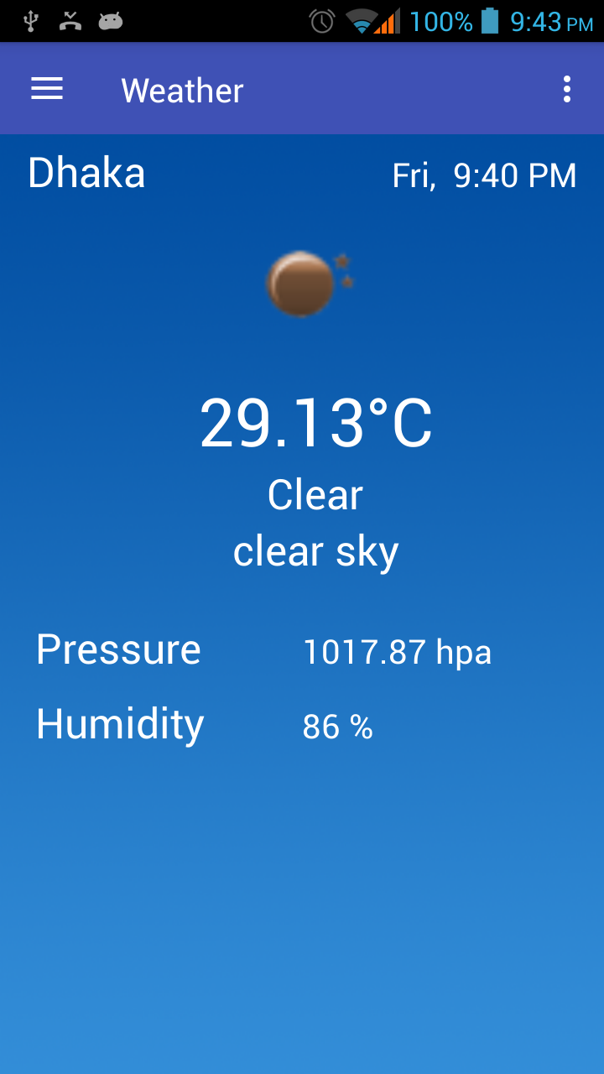
Weather

Slide 12
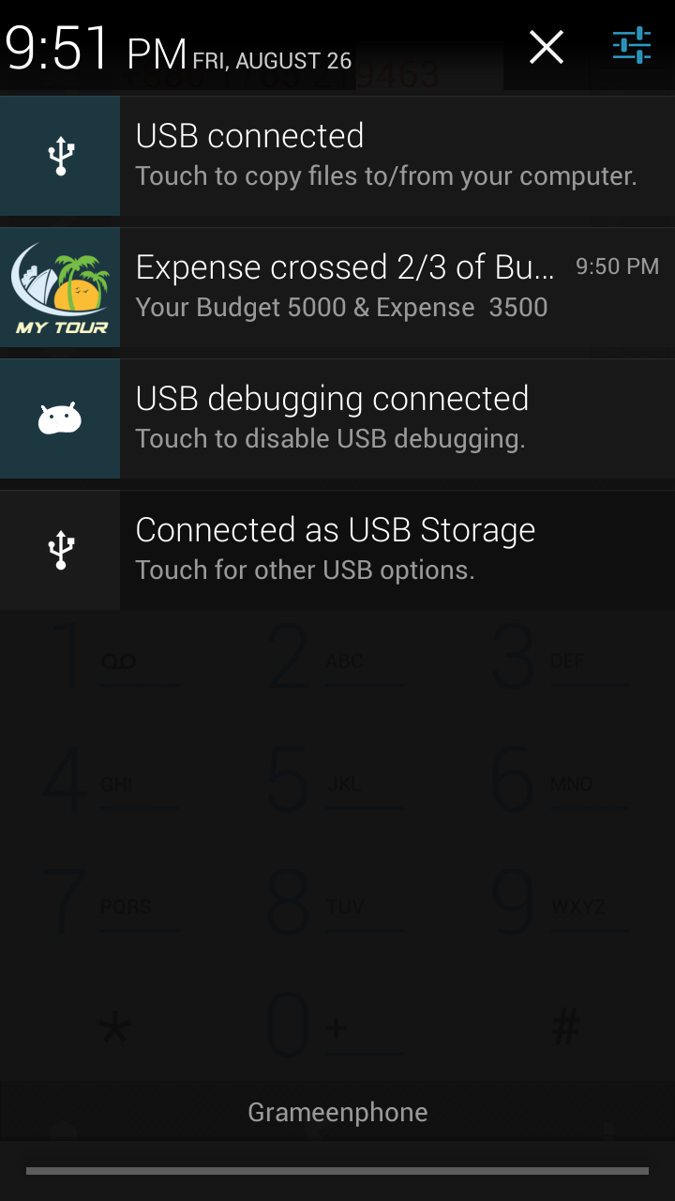
Notification

Slide 13
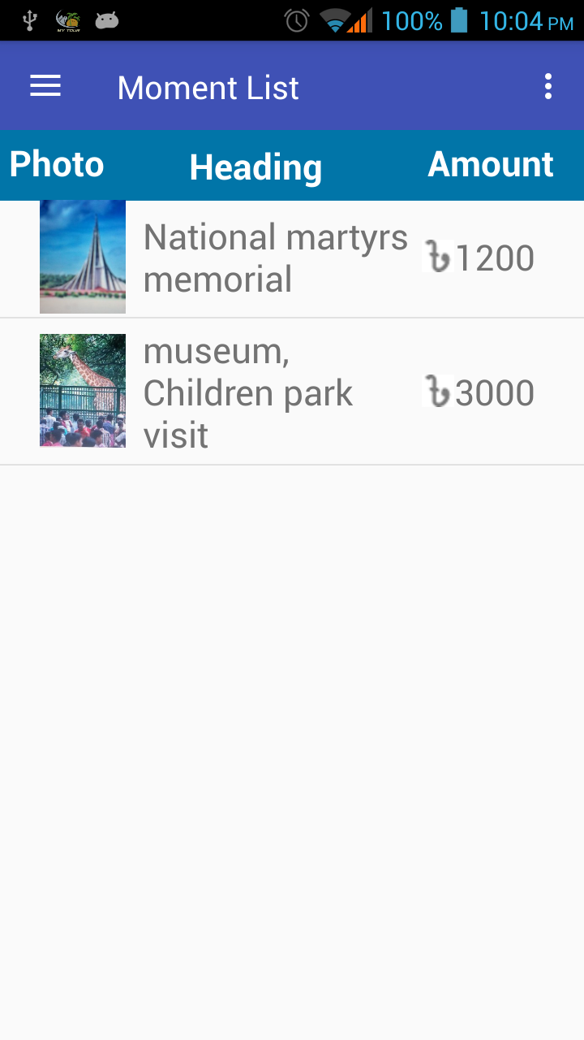
Moment List

Slide 14
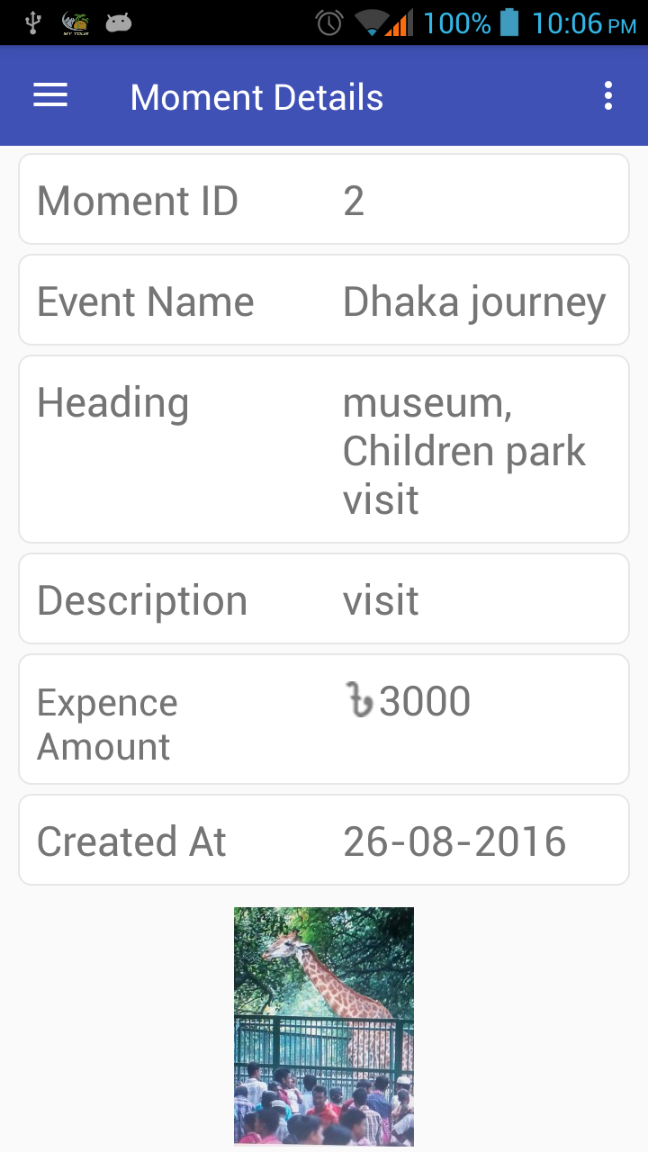
Moment Details

Slide 15
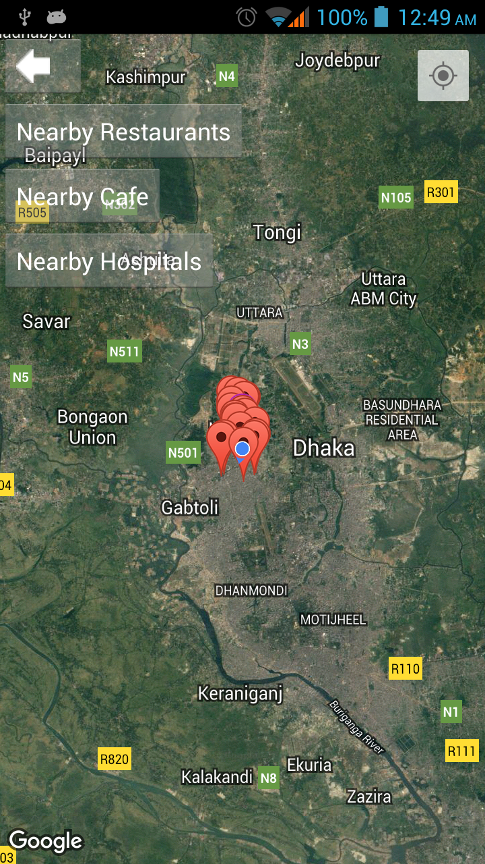
Near By

Slide 16
The End

